Slide 1

Mathematical Modeling and Engineering Problem solving
Chapter 1

Slide 2
Numerical methods are techniques by which mathematical problems are formulated so that they can be solved with arithmetic operations (involves large numbers of tedious arithmetic calculations).

Slide 3
Non-Computer Methods
Analytical (Exact) Methods: can be derived for a limited class of problems (e.g. linear models with a simple geometry). Most real problems are nonlinear and involve complex shapes and processes.
Graphical Solutions: (e.g. Plots) Limited to problems that can be described using three or fewer dimensions.
Calculators: Slow, tedious

Slide 4
Although analytical solutions are still extremely valuable for problem solving and for providing insight, numerical methods represent alternative that greatly enlarge our capabilities to solve problems.

Slide 5
Why study numerical methods?
Numerical methods are extremely powerful problem solving tools (can handle large systems of equations, nonlinearities etc.)
Numerical methods are an efficient vehicle for learning to program:
  İllustrate the power and limitations of computers
  Acknowledge and control errors of approximation.
Numerical methods provide a vehicle to reinforce your understanding of mathematics by reducing higher mathematics to basic arithmetic equations.

Slide 6
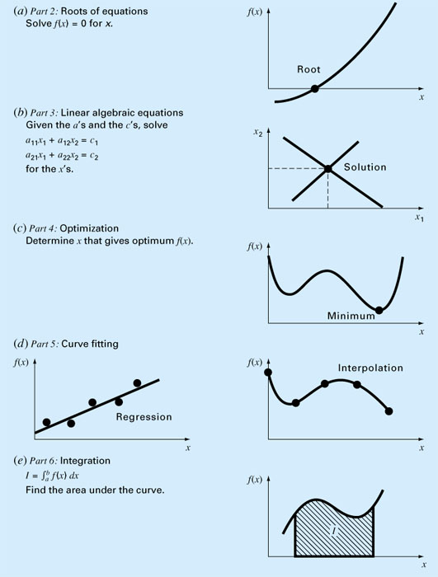
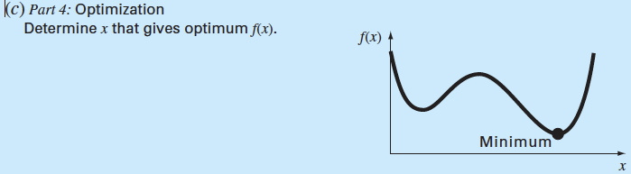
Every part in this book requires some mathematical background
-- Single and multi-variable
unconstrained optimization
-- Constrained optimization
with emphasis on linear
programming.
- Regression: There is error in data
- Interpolation: Determine intermediate values for error-free data.

Slide 7
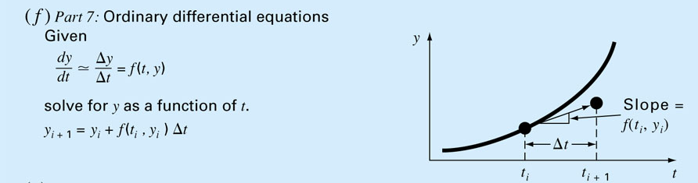
- Initial value
problems
- Boundary value
problems

Slide 8
Computers are great tools, however, without fundamental understanding of engineering problems, they will be useless.

Slide 9
Engineering Simulations
Finite element analysis (FEA) and product design services
Computational Fluid Dynamics (CFD)
Molecular Dynamics
Particle Physics
N-Body Simulations
Earthquake simulations
Development of new products and performance improvement of existing products
Benefits of Simulations
Cost savings by minimizing material usage.
Increased speed to market through reduced product development time.
Optimized structural performance with thorough analysis
Eliminate expensive trial-and-error.

Slide 10
Mathematical Model
A formulation or equation that expresses the essential features of a physical system or process in mathematical terms.
dependent variable = f(independent variables,
parameters,forcing functions)
Dependent variable: reflects the behaviour or state of the system.
Independent variable: generally time or space.
Parameters: systems’ properties.
Forcing functions: external influences

Slide 11
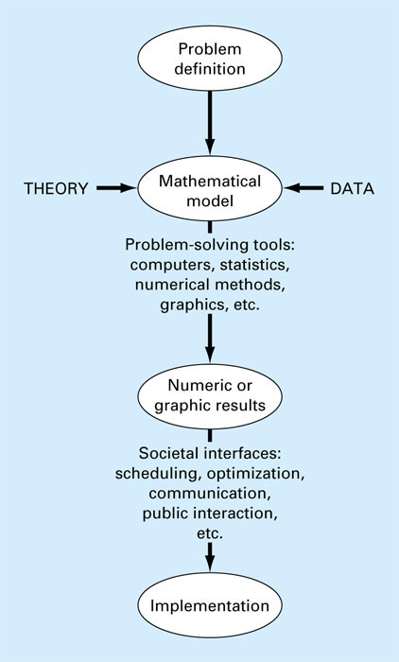
The Engineering
Problem Solving
Process

Slide 12
Parachutist Problem
Problem statement: A parachutist of mass 68.1kg jumps out of a stationary hot air balloon. We would like to compute his velocity prior to opening the chute.

Slide 13
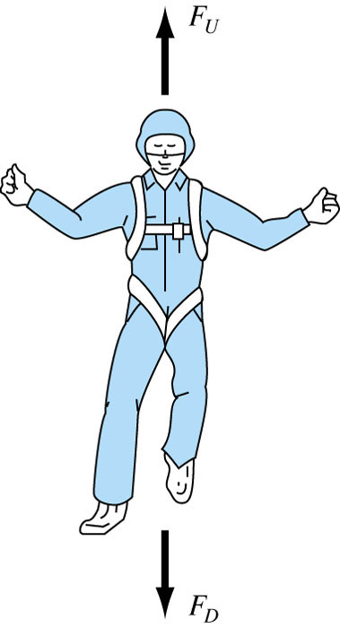

Newton’s 2nd law of Motion
“The time rate change of momentum of a body is equal to the resulting force acting on it.”
Formulated as F = m.a
F = net force acting on the body
m = mass of the object (kg)
a = its acceleration (m/s²)
Some complex models may require more sophisticated mathematical techniques than simple algebra
  Example, modeling of a falling parachutist:
  F_{U} = Force due to air resistance = -cv (c = drag coefficient)
  F_{D} = Force due to gravity = mg
Accounts for the shape
or surface roughness of
the object, that affect air resistance.

Slide 14
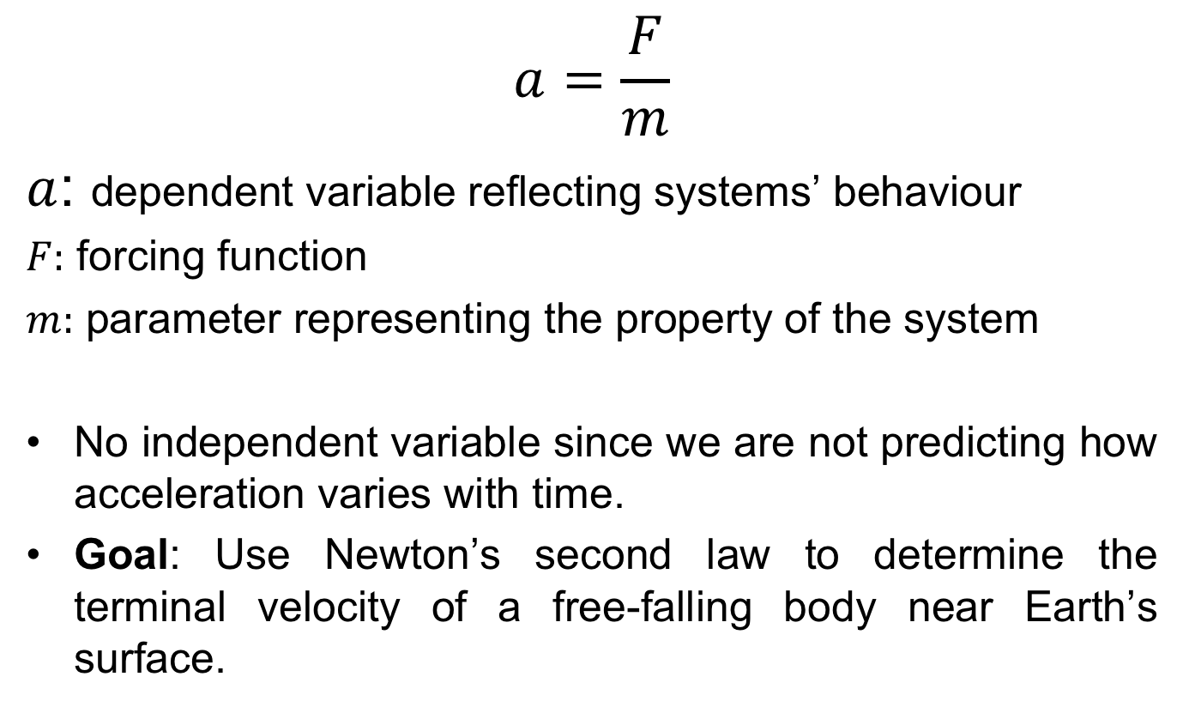

Slide 15
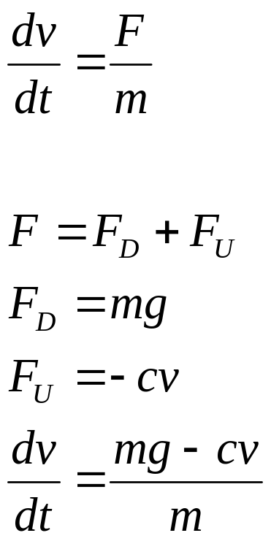
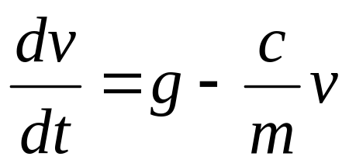
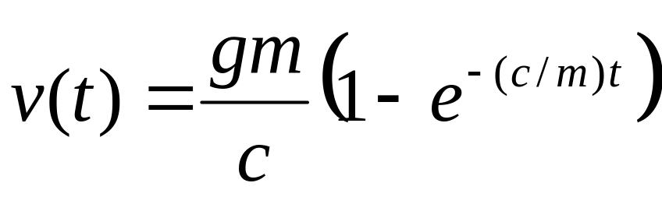
This is a first order ordinary differential equation. We would like to solve for v (velocity).
It can not be solved using algebraic manipulation
Analytical Solution:
If the parachutist is initially at rest (v=0 at t=0), using calculus dv/dt can be solved to give the result:
Independent variable
Dependent variable
Forcing function
Parameters

Slide 16
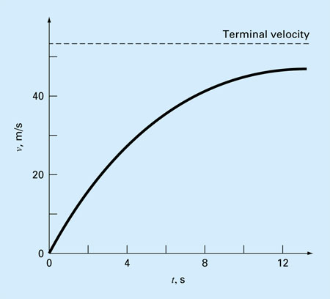
Analytical Solution
If v(t) could not be solved analytically, then
we need to use a numerical method to solve it
Terminal velocity is constant (eventually
the force of gravity will be in balance with
the air resistance. The net force is zero.)
g = 9.8 m/s² c =12.5 kg/s
m = 68.1 kg
t (sec.) | V (m/s)
0 | 0
2 | 16.40
4 | 27.77
8 | 41.10
10 | 44.87
12 | 47.49
∞ | 53.39
**Run analpara.m, analpara2.m, and analpara4.m
at W:\228\MATLAB\1-2

Slide 17
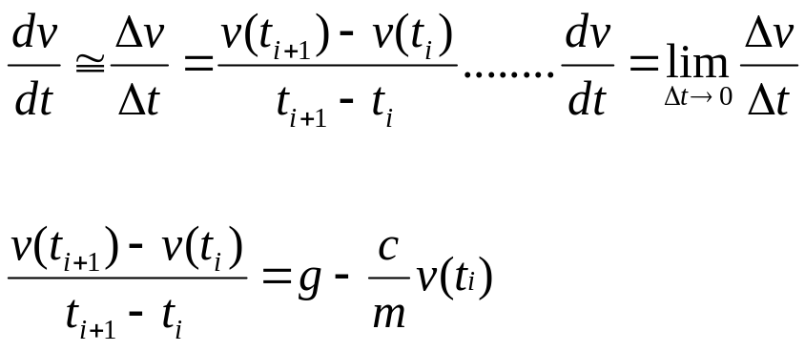
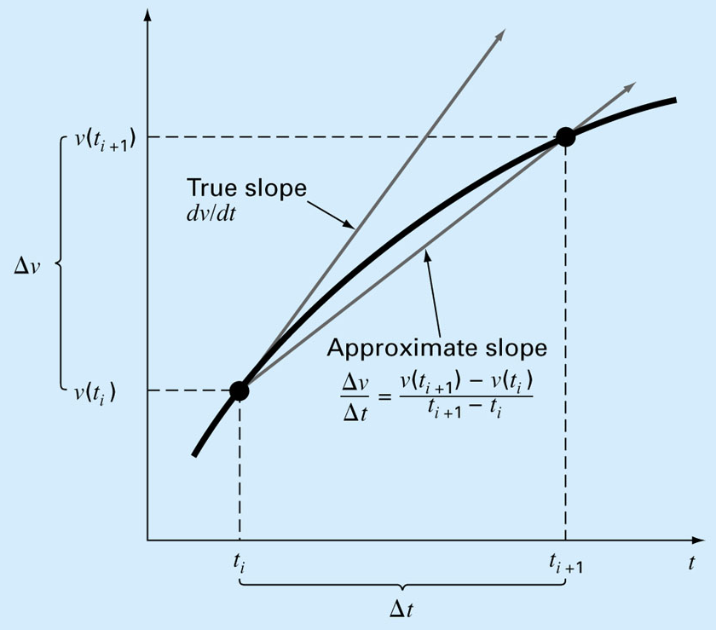
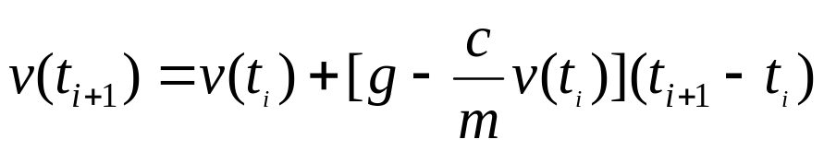
Numerical Solution
This equation can be rearranged to yield
t (sec.) | V (m/s)
0 | 0
2 | 19.60
4 | 32.00
8 | 44.82
10 | 47.97
12 | 49.96
∞ | 53.39
∆t = 2 sec
To minimize the error, use a smaller step size, ∆t
No problem, if you use a computer!

Slide 18
slope
Step size
New value
Old value

Slide 19
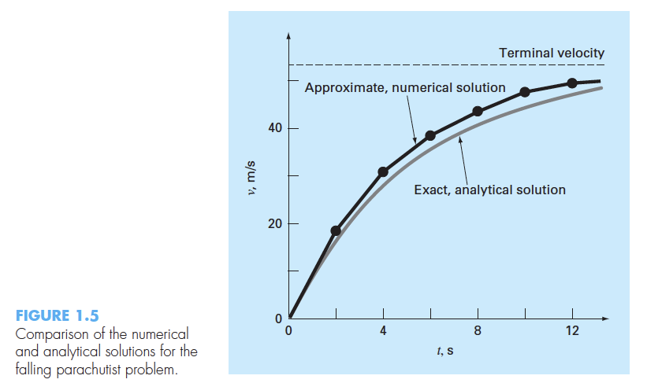

Slide 20
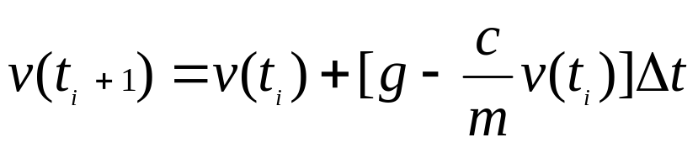
Analytical
vs.
Numerical solution
m=68.1 kg c=12.5 kg/s
g=9.8 m/s
∆t = 2 sec
∆t = 0.5 sec
∆t = 0.01 sec
t (sec.) | V (m/s)
0 | 0
2 | 16.40
4 | 27.77
8 | 41.10
10 | 44.87
12 | 47.49
∞ | 53.39
t (sec.) | V (m/s)
0 | 0
2 | 19.60
4 | 32.00
8 | 44.82
10 | 47.97
12 | 49.96
∞ | 53.39
t (sec.) | V (m/s)
0 | 0
2 | 17.06
4 | 28.67
8 | 41.95
10 | 45.60
12 | 48.09
∞ | 53.39
t (sec.) | V (m/s)
0 | 0
2 | 16.41
4 | 27.83
8 | 41.13
10 | 44.90
12 | 47.51
∞ | 53.39
CONCLUSION: If you want to minimize the error, use a smaller step size, ∆t
*Run numpara2.m at W:\228\MATLAB\1-2

